Slide 1
INVESTMENT CASE STUDY SUBMISSION
Group Name:
Navodita Mathur
B. Swimitha Reddy
Asra Naseem
K. Mohan Varun Teja

Slide 2
<Abstract>
BUSINESS OBJECTIVE : To invest where others are investing, implying that the best sectors and countries are the ones where most investors are investing.
TYPES OF ANALYSIS PERFORMED :
Three types of analysis are performed on the dataset
Investment type Analysis
Country Analysis
Sector Analysis

Slide 3
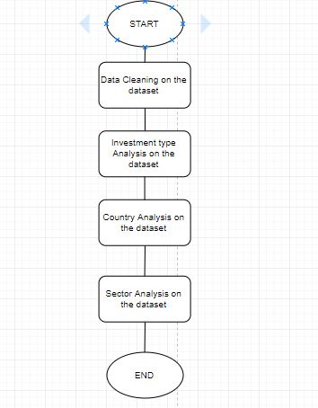
<Problem solving methodology>

Slide 4
<Analysis>
Investment Type Analysis :
AIM :
In this analysis we consider all the funding types like seed, angel, venture etc and find out average amount of funding in each type.
According to it we also find out the funding type in which spark funds fall based on the conditions, that the company can only invest between 5-15 million USD.
OUTPUT :
So according to the details presented to us regarding spark funds it is stated that spark funds can invest between 5-15 million USD
.Therefore as we know the average amount of each funding type, we can say that spark funds fall under VENTURE funding type.
The amount of investment in each investment type is plotted as shown in the plot 1.

Slide 5
<Analysis>
Country Analysis
AIM :
Sparks Fund wants to invest in countries with the highest amount of funding for the chosen investment type.
We want to invest in only the english speaking countries so as to achieve broader communication.
We need to find top three english speaking countries where most investments are occurring.
OUTPUT :
Therefore top 3 countries which have highest funding and whose official language is ENGLISH are USA, GREAT BRITAIN,INDIA
The amount of investment in each country is plotted as shown in plot 2

Slide 6
<Analysis>
Sector Analysis
AIM :
Since we already know the investment type and the countries to be invested in, we need to find the sectors where most investments are occurring.
We need to find the top three sectors in top three countries where most investments are occurring.
OUTPUT :
The top three sectors where most investments are occurring in three differen countries are found.
The amount of investment in each top three sectors in three top english speaking countries are plotted in plot 3.

Slide 7
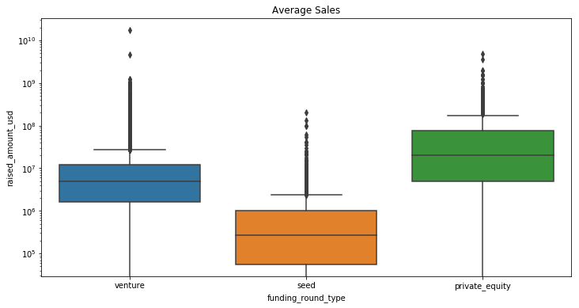
<Results>
Plot 1

Slide 8
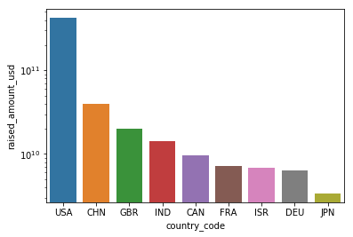
<Results>
Plot 2

Slide 9
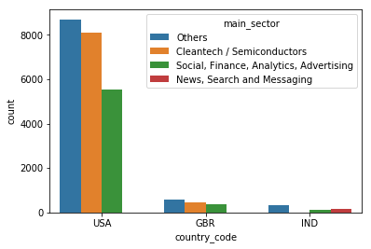
<Results>
Plot 3

Slide 10
<Conclusions>
INVESTMENT ANALYSIS : Sparks Fund can invest in venture funding type
COUNTRY ANALYSIS : Sparks Fund can invest in USA, GBR and IND countries
SECTOR ANALYSIS : 1)Spark Fund can invest in sectors ‘Others’ , ‘Cleantech / Semiconductors’ , ‘Social, Finance, Analytics, Advertising ’ in USA
2)Spark Fund can invest in sectors ‘Others’ , ‘Cleantech / Semiconductors’ , ‘Social, Finance, Analytics, Advertising ’ in GBR
3)Spark Fund can invest in sectors ‘Others’ , ‘News, Search and Messaging ’ , ‘Social, Finance, Analytics, Advertising ’ in IND
After performing analysis it is found that Sparks Fund can invest in the above to achieve greater results.

